Slide 1

Design and Analysis of Algorithms
Part V: Dealing with Hard Problems
Lecture 12: Problem Classes: P, NP, NP-Completeness
Ke Xu and Yongxin Tong
(许可 与 童咏昕)
School of CSE, Beihang University

Slide 2
Outline
Introduction to Part V
Problem Classes: P and NP
Input size of a problem
Optimization problems vs Decision problems
The class P and class NP
Introduction to NP-Completeness (NPC)
Polynomial-time reductions
The class NPC
NP-Complete problems
Optimization vs. Decision problems about NPC
Summary

Slide 3
Introduction
So far: techniques for designing efficient algorithms: divide-and-conquer, dynamic-programming, greedy-algorithms.
What happens if you can’t find an efficient algorithm for a given problem?

Slide 4
Introduction
Showing that a problem has an efficient algorithm is, relatively, easy.
“All’ that is needed is to demonstrate an algorithm.
Proving that no efficient algorithm exists for a particular problem is difficult.

Slide 5
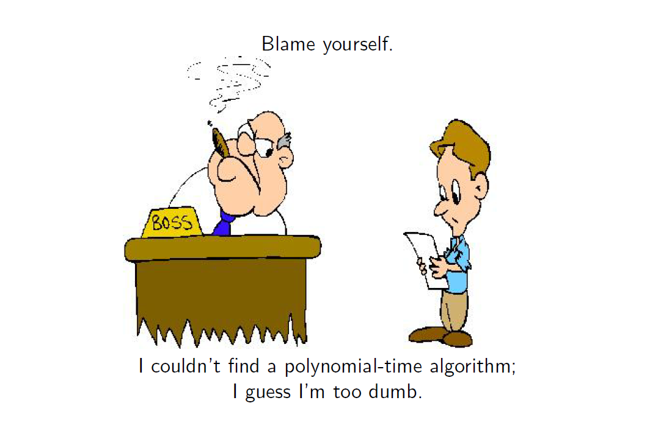
Introduction

Slide 6
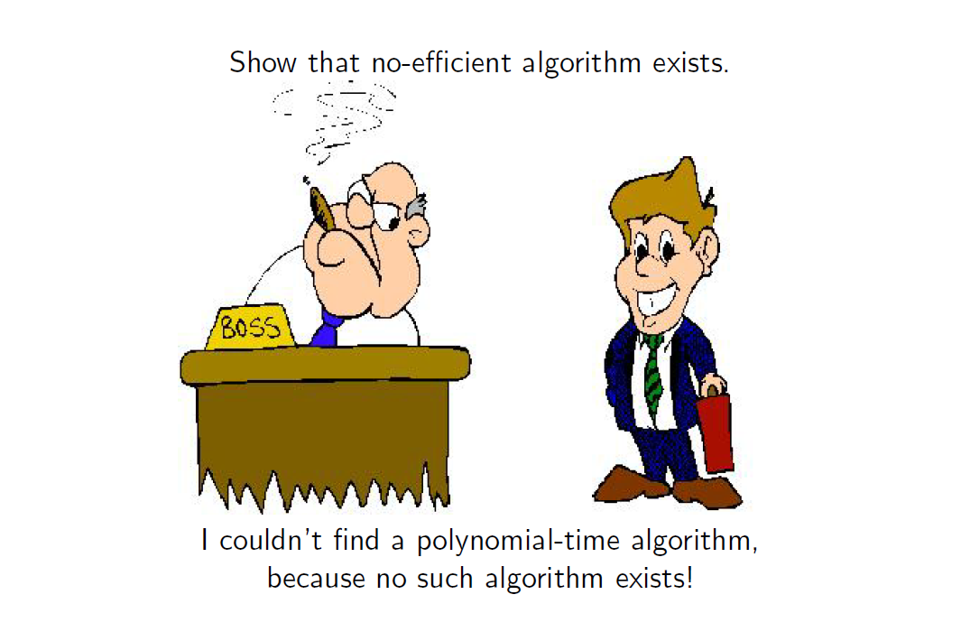
Introduction

Slide 7

Introduction
Showing that a problem has an efficient algorithm is, relatively, easy
“All that is needed is to demonstrate an algorithm.
Proving that no efficient algorithm exists for a particular problem is difficult.
We will now learn about NP-Complete Problems, which provide us with a way to approach this question.

Slide 8
Introduction
A very large class of thousands of practical problems for which it is not known if the problems have “efficient” solutions.
It is known that if any one of the NP-complete problems has an efficient solution then all of the NP-complete problems have efficient solutions.
Researchers have spent innumerable man-years trying to find efficient solutions to these problems and failed.
So, NP-Complete problems are very likely to be hard.
What do you do: prove that your problem is NP-complete.

Slide 9
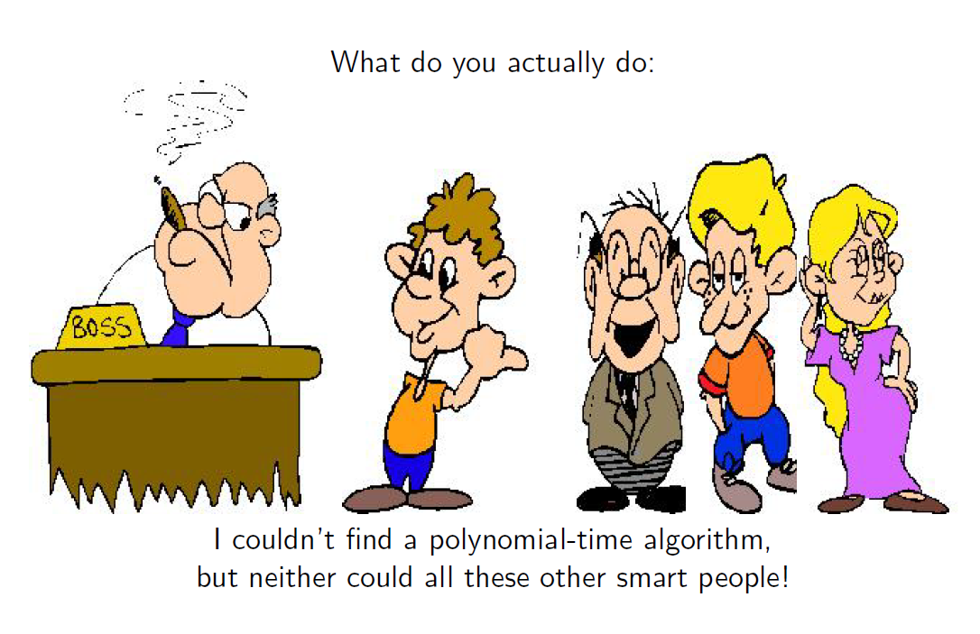
Introduction

Slide 10
Outline
Introduction to Part V
Problem Classes: P and NP
Input size of a problem
Optimization problems vs Decision problems
The class P and class NP
Introduction to NP-Completeness (NPC)
Polynomial-time reductions
The class NPC
NP-Complete problems
Optimization vs. Decision problems about NPC
Summary

Slide 11
Encoding the Inputs of Problems
Complexity of a problem is measured w.r.t the size of input.
In order to formally discuss how hard a problem is, we need to be much more formal than before about the input size of a problem.
We will therefore spend some time now discussing how to encode the inputs of problems.

Slide 12

Example
A graph G may be represented by its adjacency matrix A = [a_{ij}].
G can then be encoded as a binary string of length n²:
a₁₁…a_{1n}a₂₁…a_{2n}…a_{n1}…a_{nn}
Given the binary string, the computer can count the number of bits and then determine n, the vertices, and the edges.
Remark: In general, the inputs of any problem can be encoded as binary strings.

Slide 13
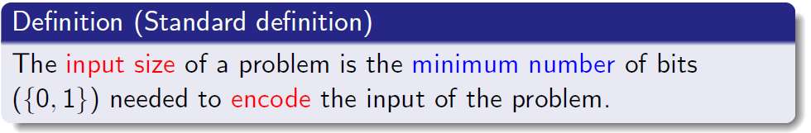
The Input Sizes of Problems
The input size of a problem may be defined in a number of ways.
Remark: The exact input size s, (minimal number of bits) determined by an optimal encoding method, is hard to compute in most cases.
However, for the complexity problems we will study, we do not need to determine s exactly.
For most problems, it is sufficient to choose some natural, and (usually) simple, encoding and use the size s of this encoding.

Slide 14
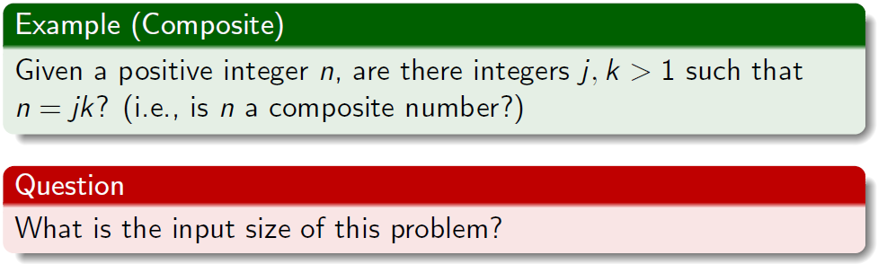
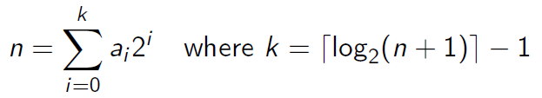
Input Size Example: Composite
Any integer n > 0 can be represented in the binary number system as a string a₀a₁ . . . a_{k} of length ⌈log₂(n + 1) ⌉, because
Therefore, a natural measure of input size is⌈log₂(n+1) ⌉ (or just log₂ n).

Slide 15
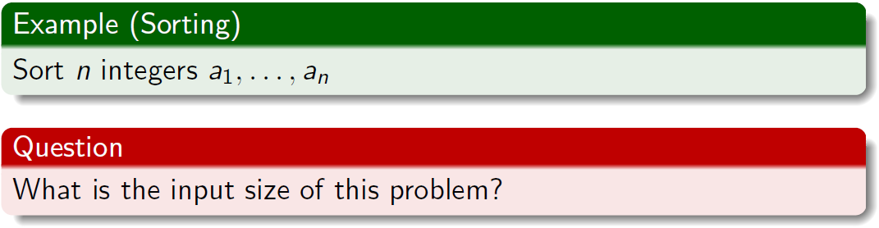
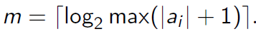
Input Size Example: Sorting
Using fixed length encoding, we write a_{i} as a binary string of length
This coding gives an input size nm.

Slide 16
Outline
Introduction to Part V
Problem Classes: P and NP
Input size of a problem
Optimization problems vs Decision problems
The class P and class NP
Introduction to NP-Completeness (NPC)
Polynomial-time reductions
The class NPC
NP-Complete problems
Optimization vs. Decision problems about NPC
Summary

Slide 17
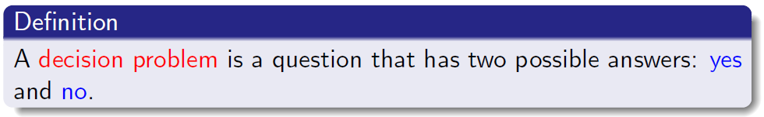
Decision Problems
If L is the problem and x is the input, we will often write x ∈ L to denote a yes answer and x ∉ L to denote a no answer.
This notation comes from thinking of L as a language and asking whether x is in the language L (yes) or not (no).
See CLRS, pp. 975-977 for more details.

Slide 18
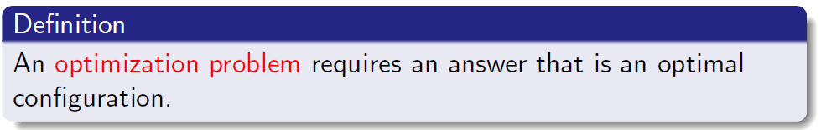
Optimization Problems
An optimization problem usually has a corresponding decision problem.
Examples that we will see:
MST vs. Decision Spanning Tree (DST),
Knapsack vs. Decision Knapsack (DKnapsack),
SubSet Sum vs. Decision Subset Sum (DSubset Sum)

Slide 19
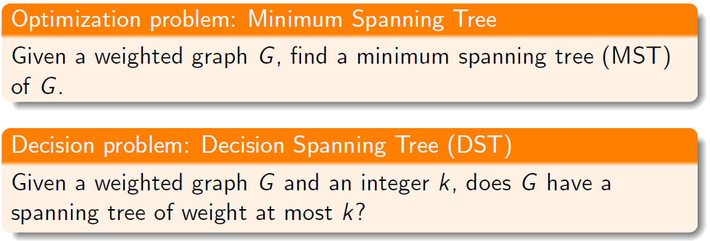
Decision Problems: MST
The inputs are of the form (G, k).
So we will write (G, k)∈DST or (G, k)∉DST to denote, respectively, yes and no answers.

Slide 20
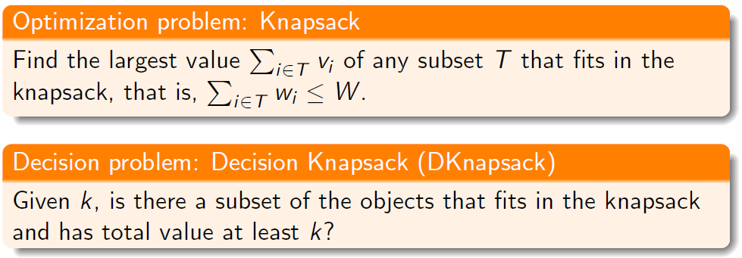
Decision Problems: Knapsack
We have a knapsack of capacity W (a positive integer) and n objects with weights w₁, ...,w_{n} and values v₁, ..., v_{n}, where v_{i} and w_{i} are positive integers.

Slide 21
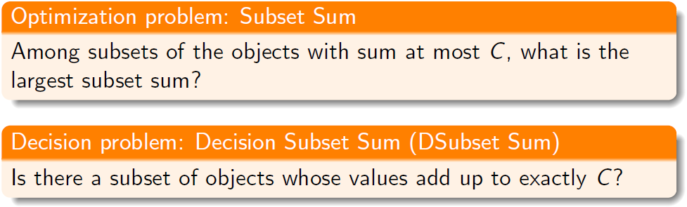
Decision Problems: Subset Sum
The input is a positive integer C and n objects whose values are positive integers s₁, ..., s_{n}.
For a more formal definition see CLRS, Section 34.5.5

Slide 22
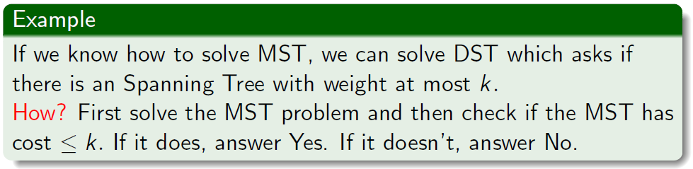
Optimization and Decision Problems
For almost all optimization problems there exists a corresponding simpler decision problem.
Given a subroutine for solving the optimization problem, solving the corresponding decision problem is usually trivial.
Thus if we prove that a given decision problem is hard to solve efficiently, then it is obvious that the optimization problem must be (at least as) hard.
Note: It will be more convenient to compare the ‘hardness’ of decision problems than of optimization problems (since all decision problems share the same form of output, either yes or no.)

Slide 23
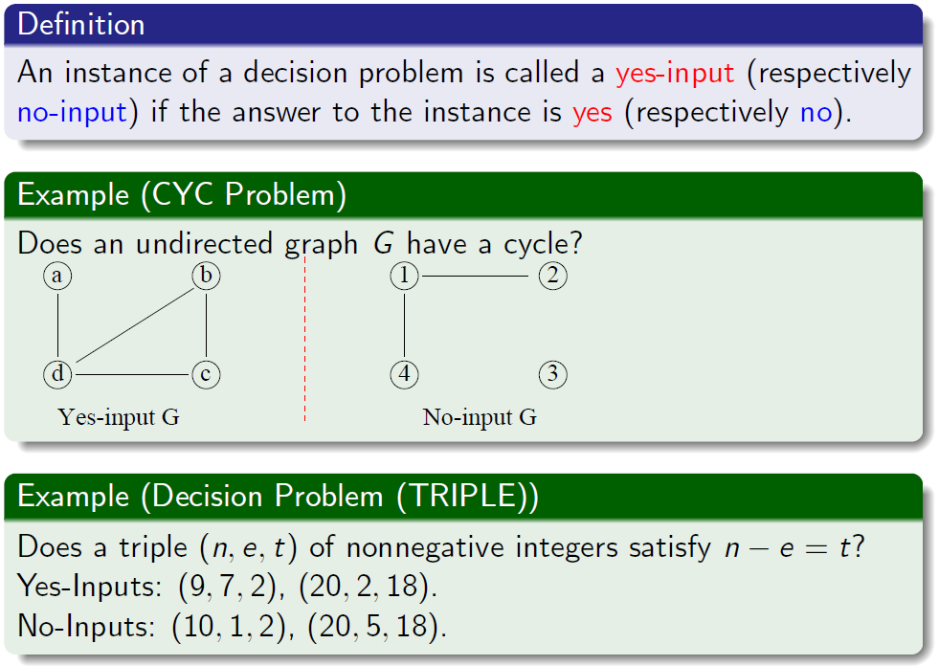
Decision Problems: Yes-Inputs ant No-Inputs

Slide 24
Outline
Introduction to Part V
Problem Classes: P and NP
Input size of a problem
Optimization problems vs Decision problems
The class P and class NP
Introduction to NP-Completeness (NPC)
Polynomial-time reductions
The class NPC
NP-Complete problems
Optimization vs. Decision problems about NPC
Summary

Slide 25

Complexity Classes
The Theory of Complexity deals with
the classification of certain “decision problems” into several classes:
the class of “easy” problems,
the class of “hard” problems,
the class of “hardest” problems;
relations among the three classes;
properties of problems in the three classes.

Slide 26
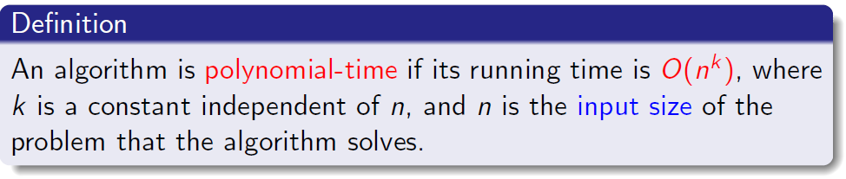
Polynomial-Time Algorithms
Remark: Whether you use n or n^{α} (for fixed a > 0) as the input size, it will not affect the conclusion of whether an algorithm is polynomial time.
This explains why we introduced the concept of two functions being of the same type earlier on.
Using the definition of polynomial-time it is not necessary to fixate on the input size as being the exact minimum number of bits needed to encode the input!

Slide 27
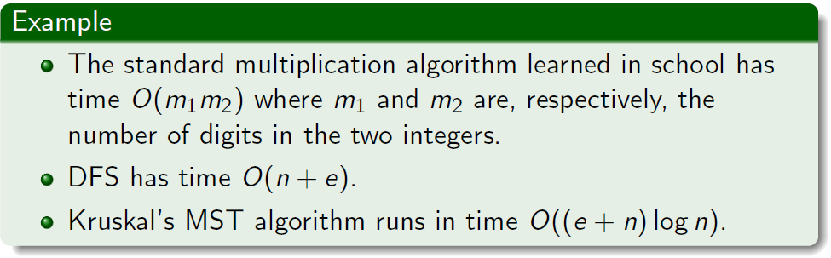
Polynomial-Time Algorithms

Slide 28
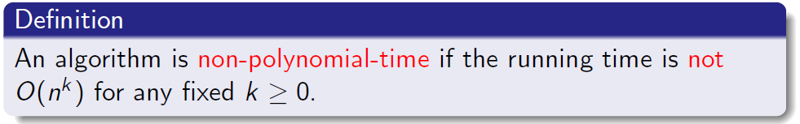
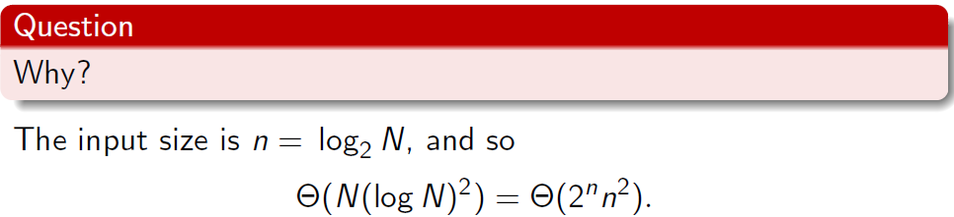
Nonpolynomial-Time Algorithms
Let’s return to the brute force algorithm for determining whether a positive integer N is a prime:
it checks, in time Θ((log N)²), whether K divides N for each K with 2 ≤ K ≤ N − 1.
The complete algorithm therefore uses Θ(N(log N)²) time.
Conclusion: The algorithm is nonpolynomial!

Slide 29
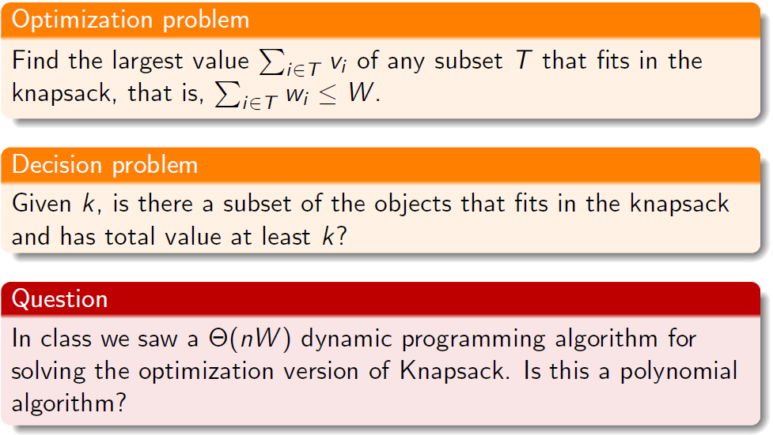
Is Knapsack Problem Polynomial?
Recall the problem. We have a knapsack of capacity W (a positive integer) and n objects with weights w₁, ...,w_{n} and values v₁, ..., v_{n}, where vi and wi are positive integers.

Slide 30
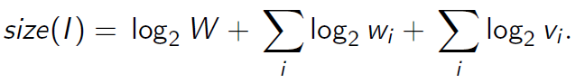
Is Knapsack Problem Polynomial?
Answer: No!
The size of the input is
nW is not polynomial in size(I). Depending upon the values of the w_{i} and v_{i} , nW could even be exponential in size(I).
It is unknown as to whether there exists a polynomial time algorithm for Knapsack.
In fact, Knapsack is a NP-Complete problem.

Slide 31
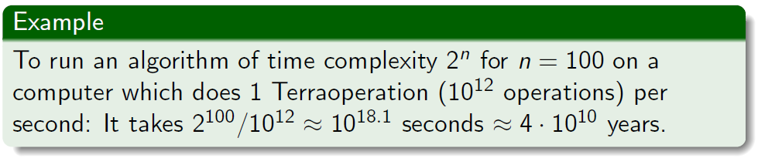
Polynomial- vs. Exponential-Time
Exponential-time algorithms are impractical.
For the sake of our discussion of complexity classes Polynomial-time algorithms are ”practical”.
Note: in reality an O(n²⁰) algorithm is not really practical.

Slide 32
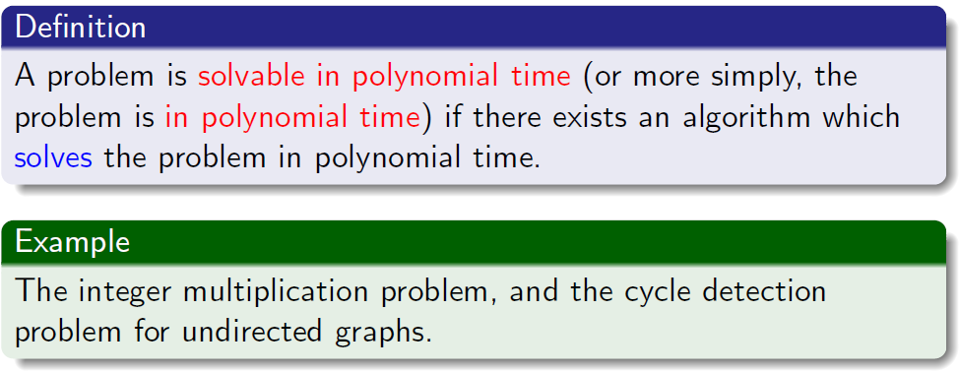
Polynomial-Time Solvable Problems
Exponential-time algorithms are impractical.
Remark: Polynomial-time solvable problems are also called tractable problems.

Slide 33
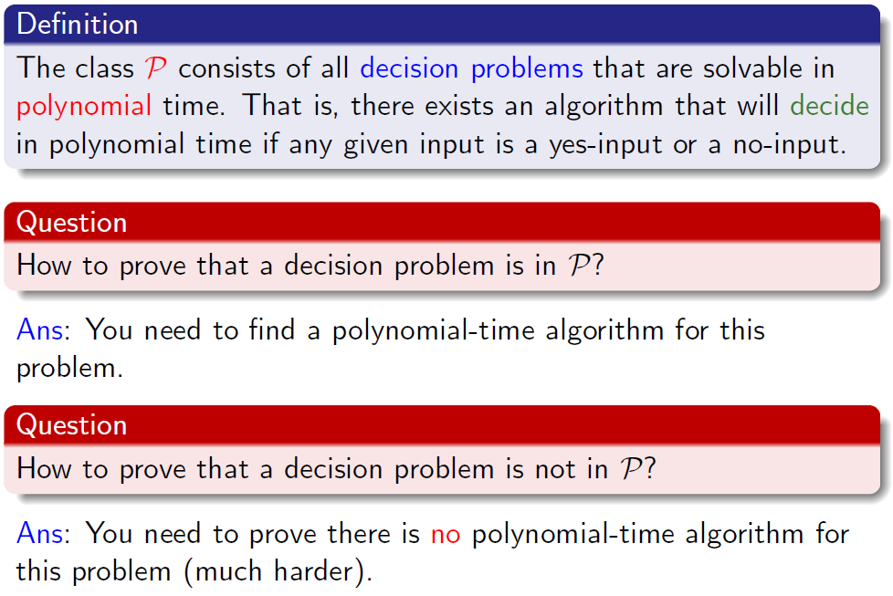
The Class P

Slide 34
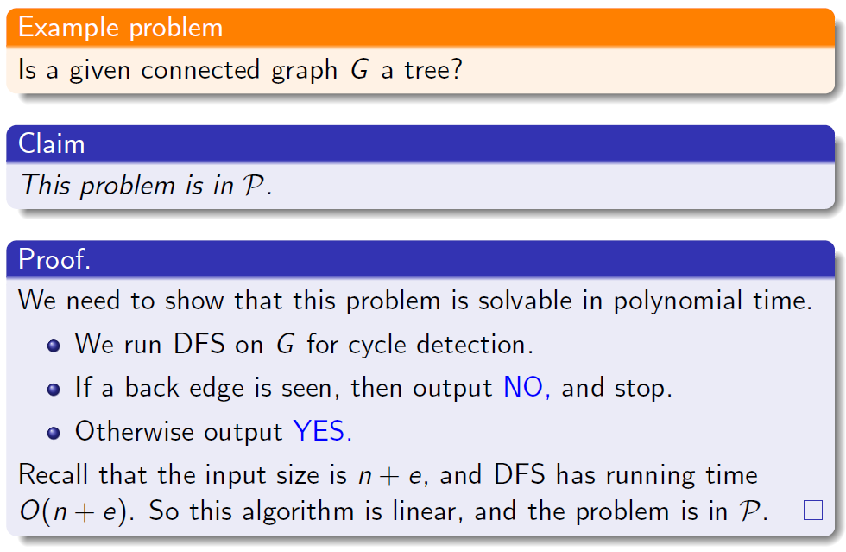
The Class P: An Example

Slide 35
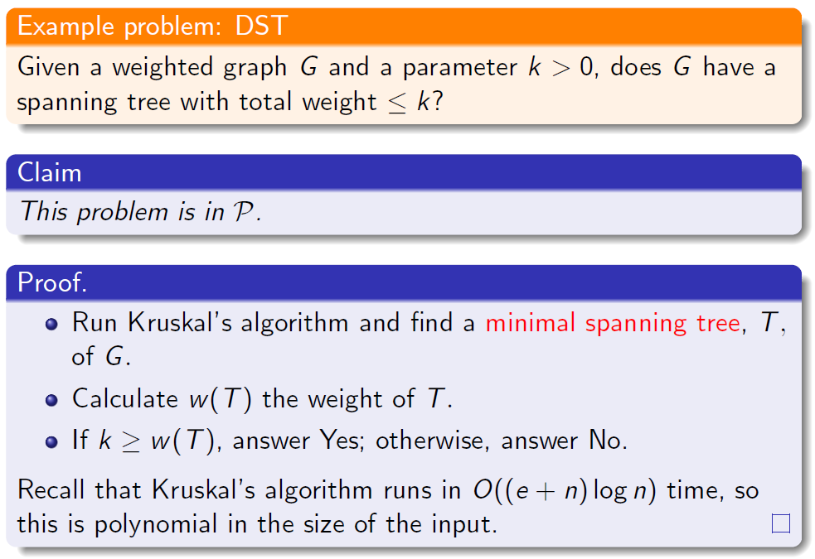
The Class P: An Example

Slide 36
Certificates and Verifying Certificates
We have already seen the class P. We are now almost ready to introduce the class NP.
Observation: A decision problem is usually formulated as:

Slide 37
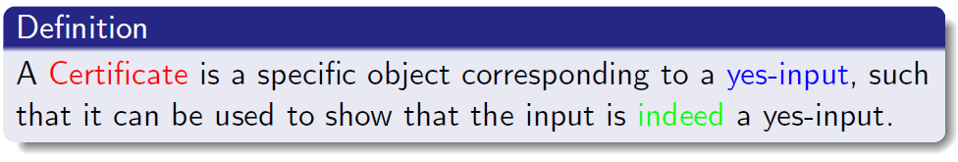
Certificates and Verifying Certificates
By definition, only yes-input needs a certificate (a no-input does not need to have a ’certificate’ to show it is a no-input).
Verifying a certificate: Given a presumed yes-input and its corresponding certificate, by making use of the given certificate, we verify that the input is actually a yes-input.

Slide 38
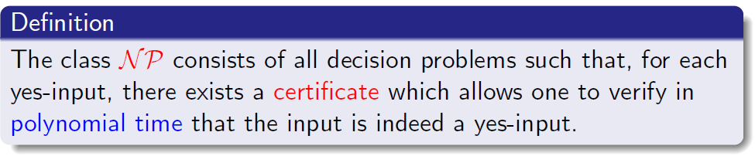
The Class NP
Remark: NP stands for “nondeterministic polynomial time”. The class NP was originally studied in the context of nondeterminism, here we use an equivalent notion of verification.

Slide 39

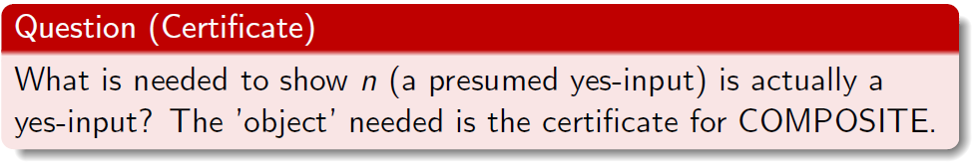
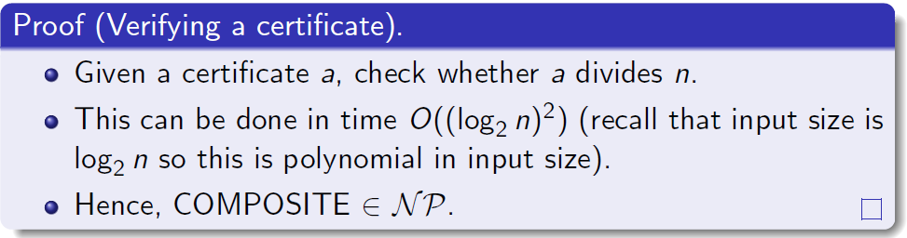
COMPOSITE ∈ NP
For COMPOSITE, an yes-input is just the integer n that is composite.
Ans: The certificate is an integer a (1 < a < n) with the property that it divides n.

Slide 40
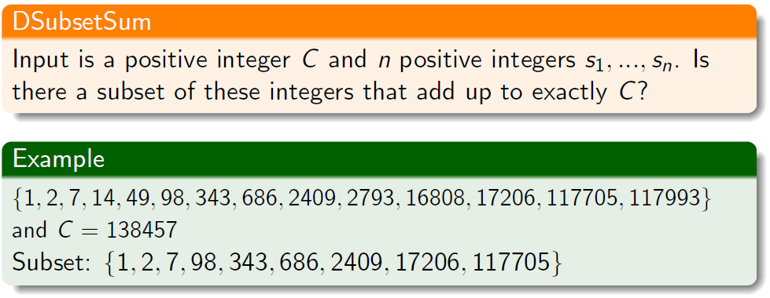
DSubsetSum ∈ NP
A DSubsetSum yes-input consists of n numbers, and an integer C, such that there is a subset of those integers that add up to C.

Slide 41
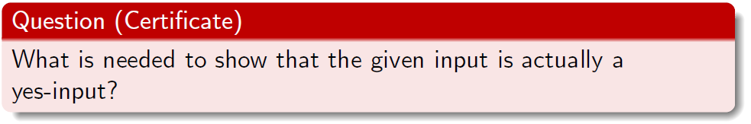
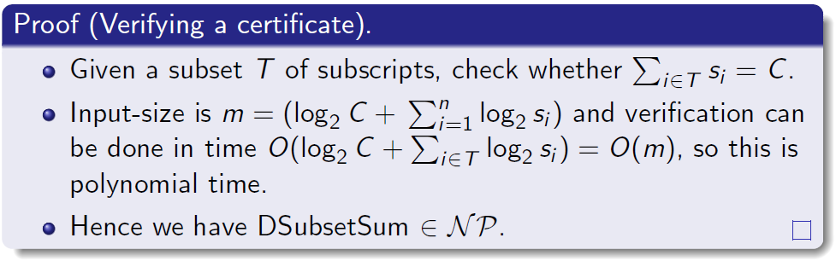
DSubsetSum ∈ NP
Ans: A subset T of subscripts with the corresponding integers add up to C.

Slide 42
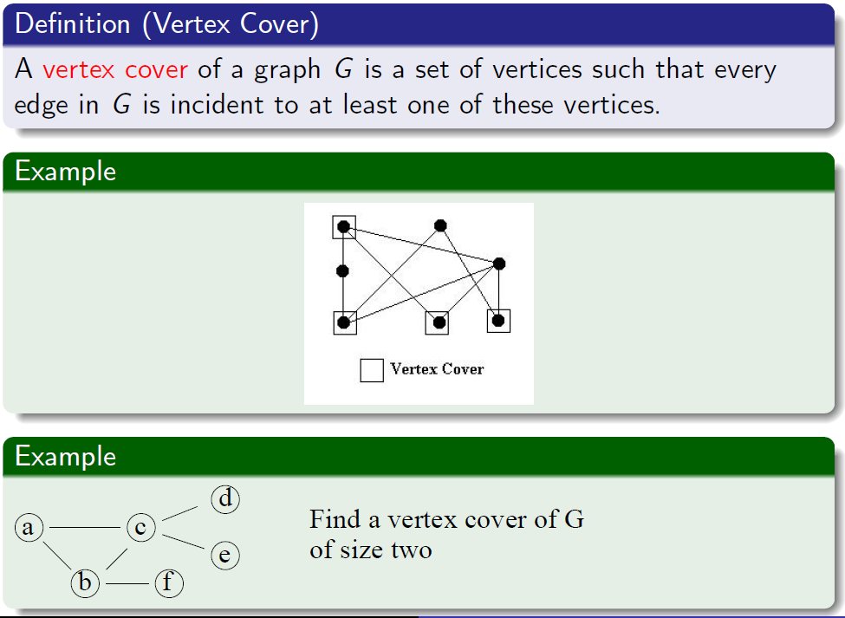
DVC ∈ NP

Slide 43
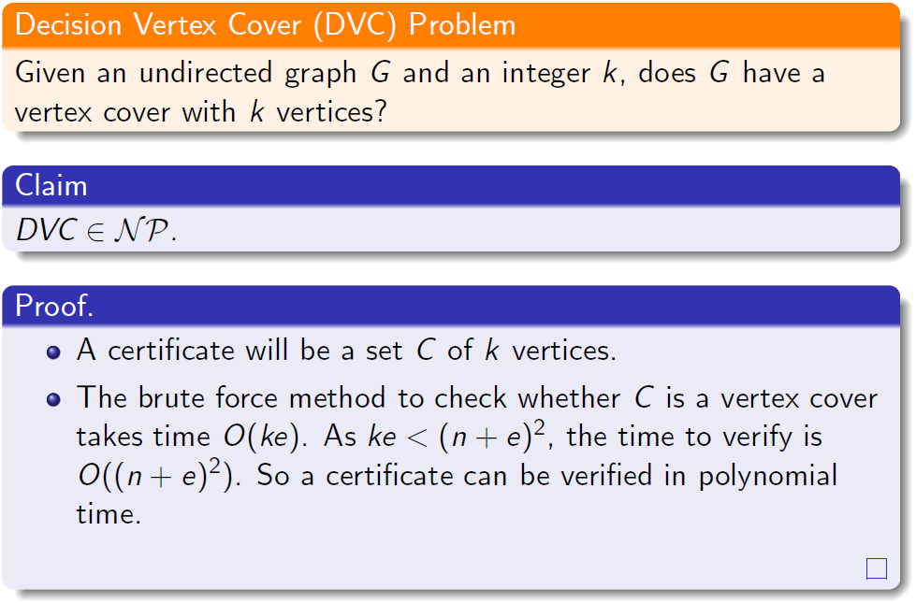
DVC ∈ NP

Slide 44
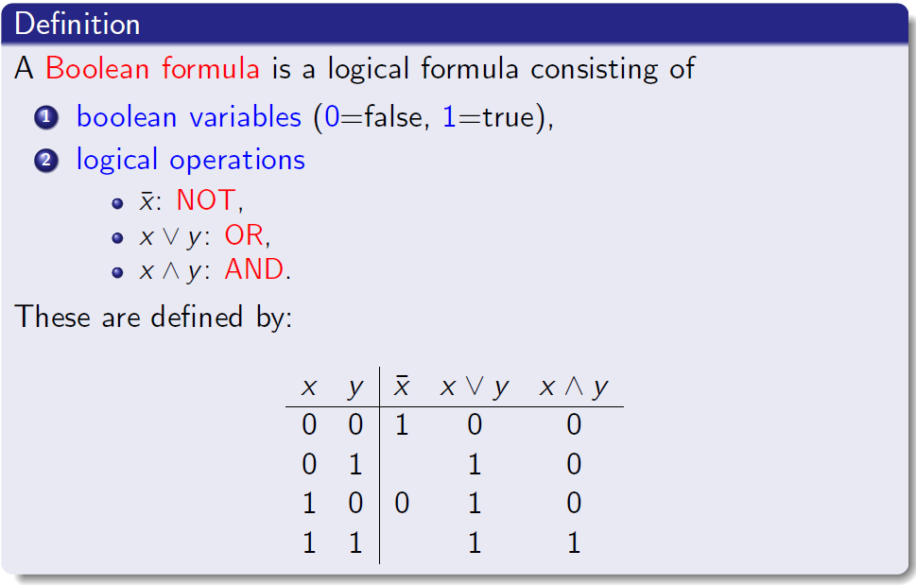
Satisfiability I
We will now introduce Satisfiability (SAT), which, we will see later, is one of the most important NP problems.

Slide 45
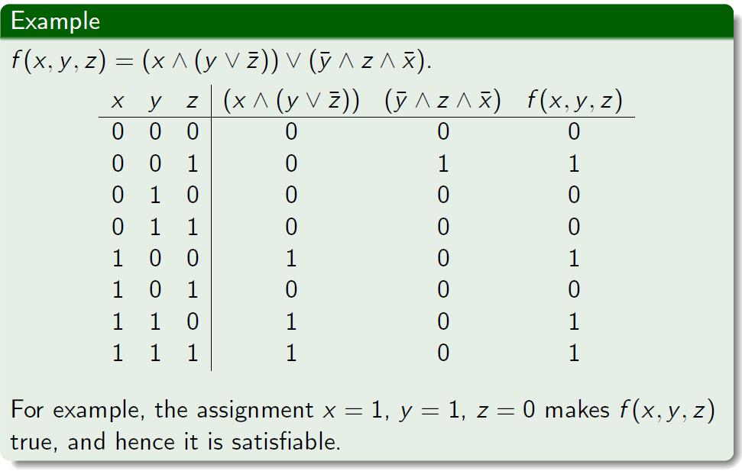
Satisfiability II
A given Boolean formula is satisfiable if there is a way to assign truth values (0 or 1) to the variables such that the final result is 1.

Slide 46
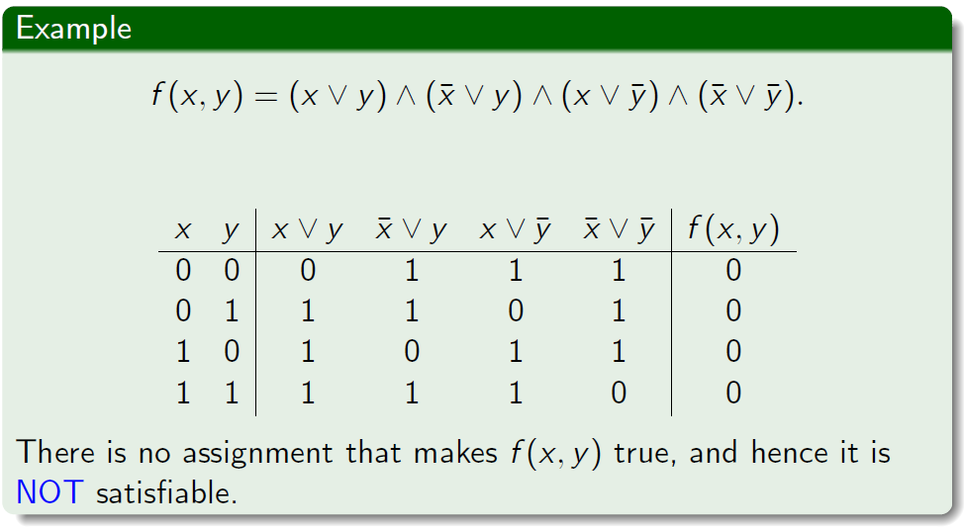
Satisfiability III

Slide 47
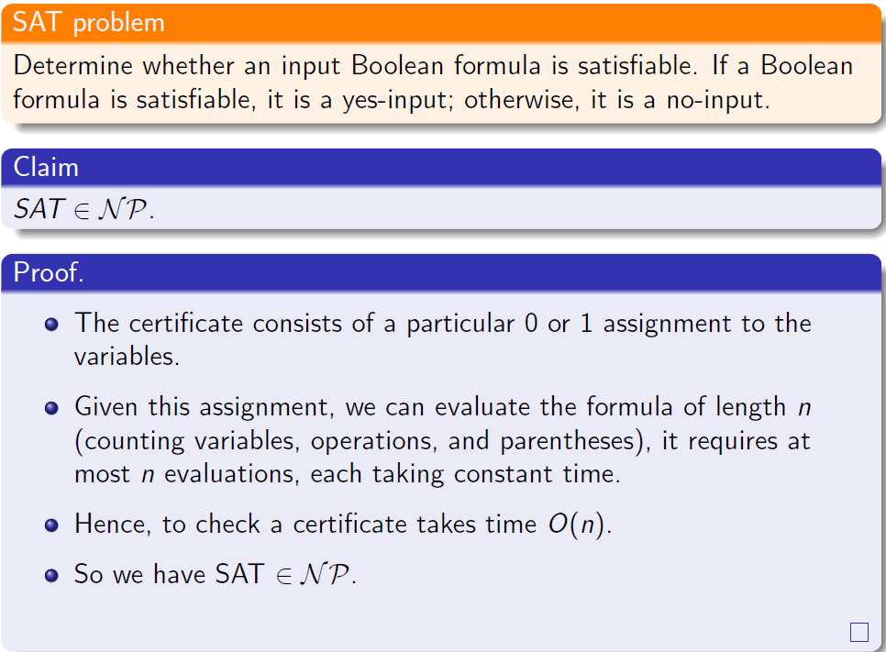
SAT ∈ NP

Slide 48
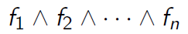
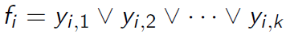
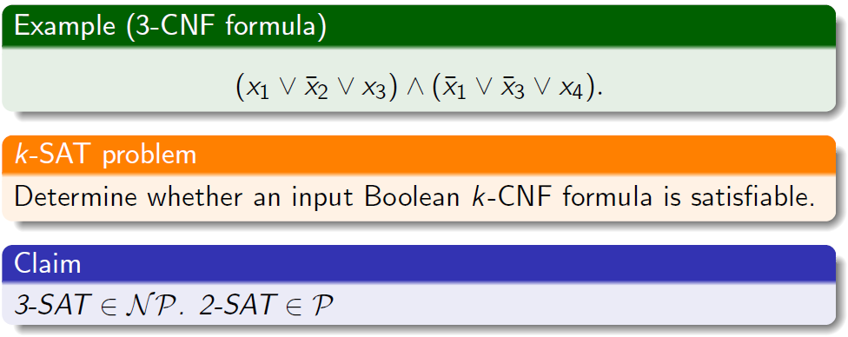
k-SAT ∈ NP
For a fixed k, consider Boolean formulas in k-conjunctive normal form (k-CNF):
where each f_{i} is of the form
where each y_{i,j} is a variable or the negation of a variable.

Slide 49
Some Decision Problems in NP
We have given proofs for:
Decision subset sum problem (DSubsetSum),
Satisfiability (SAT),
Decision vertex cover problem (DVC).
Some others (without proofs given; try to find proofs):
Decision minimum spanning tree problem (DMST),
Decision 0-1 knapsack problem (DKnapsack).

Slide 50
P = NP?
One of the most important problems in computer science is whether P = NP or P ≠ NP? Observe that P ⊆ NP.
Given a problem π ∈ P, and a certificate, to verify the validity of a yes-input (an instance of π), we can simply solve π in polynomial time (since π ∈ P). It implies π ∈ NP.
Intuitively, NP ⊆ P is doubtful.
After all, just being able to verify a certificate (corresponding to a yes-input) in polynomial time does not necessary mean we can tell whether an input is a yes-input in polynomial time.
However, 30 years after the P = NP? problem was first proposed, we are still no closer to solving it and do not know the answer. The search for a solution, though, has provided us with deep insights into what distinguishes an “easy” problem from a “hard” one.

Slide 51
Outline
Introduction to Part V
Problem Classes: P and NP
Input size of a problem
Optimization problems vs Decision problems
The class P and class NP
Introduction to NP-Completeness (NPC)
Polynomial-time reductions
The class NPC
NP-Complete problems
Optimization vs. Decision problems about NPC
Summary

Slide 52
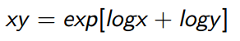
What is a Reduction?
Reduction is a relationship between problems.
Problem Q can be reduced to Q’ if every instance of Q can be “rephrased” as an instance of Q’
Example 1:
Q: multiplying two positive numbers.
Q’: adding two numbers.
Q can be reduced to Q’ via a logarithmic transformation
If Q can be reduced to Q’, Q is “no harder to solve” than Q’.

Slide 53
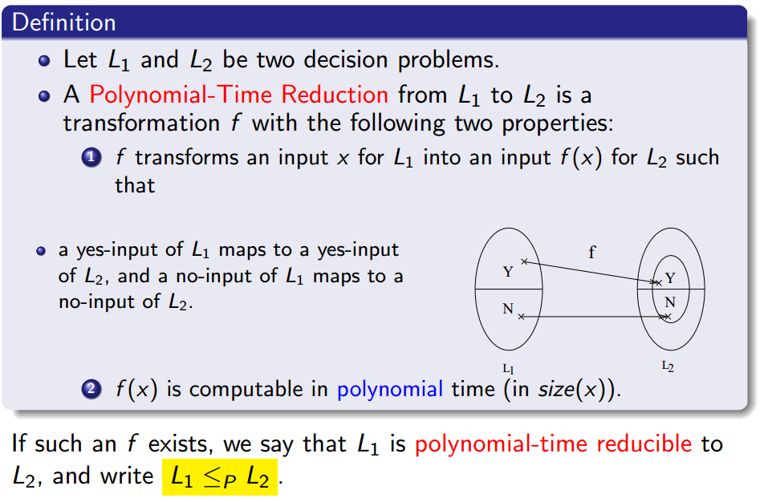
Polynomial-Time Reductions

Slide 54
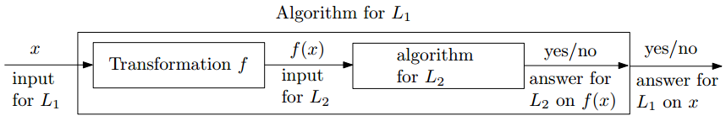
Polynomial-Time Reductions
Intuitively, L₁ ≤_{P} L₂ means L₁ is no harder than L₂.
Given an algorithm A₂ for the decision problem L₂, we can develop an algorithm A₁ to solve L₁:
If A₂ is polynomial-time algorithm, so is A₁.

Slide 55
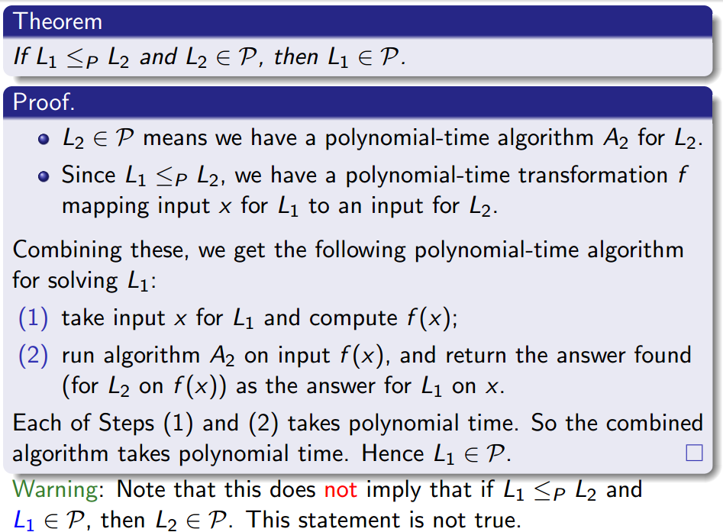
Polynomial-Time Reductions f:L₁→L₂

Slide 56
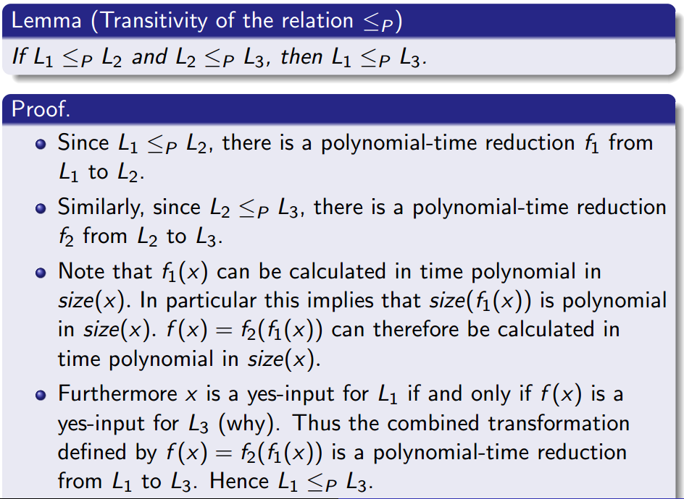
Reduction between Decision Problems

Slide 57
Outline
Introduction to Part V
Problem Classes: P and NP
Input size of a problem
Optimization problems vs Decision problems
The class P and class NP
Introduction to NP-Completeness (NPC)
Polynomial-time reductions
The class NPC
NP-Complete problems and proofs
Optimization vs. Decision problems about NPC
Summary

Slide 58
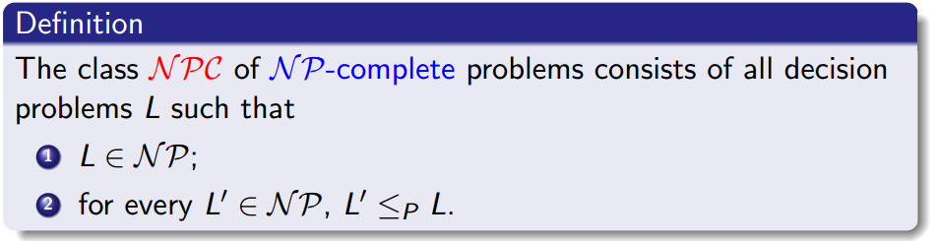
The Class NP-Complete (NPC)
We have finally reached our goal of introducing class NPC.
Intuitively, NPC consists of all the hardest problems in NP.

Slide 59
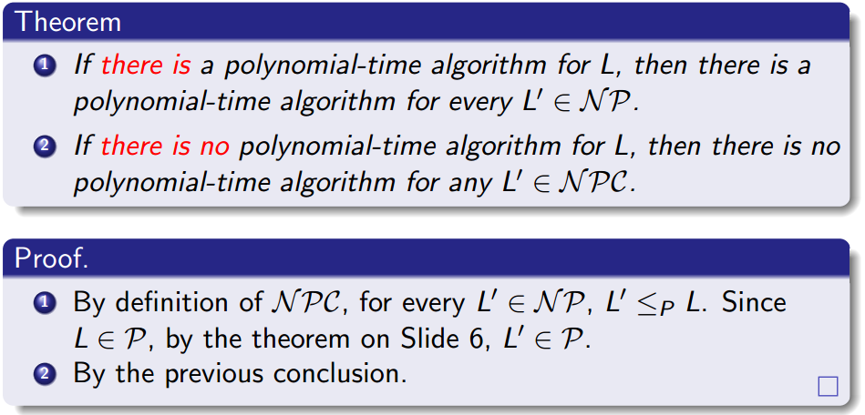
NP-Completeness and Its Properties
Let L be any problem in NPC.

Slide 60
NP-Completeness and Its Properties
According to the above theorem,
either all NP-Complete problems are polynomial time solvable, or
all NP-Complete problems are not polynomial time solvable.
This is the major reason we are interested in NP-Completeness.

Slide 61
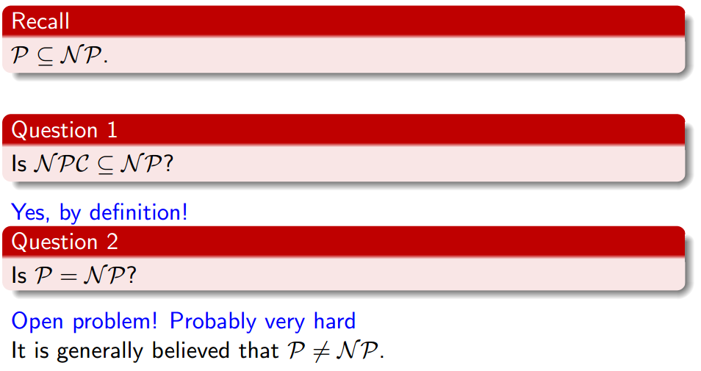
The Classes P, NP, and NPC

Slide 62

The Classes P, NP, and NPC

Slide 63
Outline
Introduction to Part V
Problem Classes: P and NP
Input size of a problem
Optimization problems vs Decision problems
The class P and class NP
Introduction to NP-Completeness (NPC)
Polynomial-time reductions
The class NPC
NP-Complete problems
Optimization vs. Decision problems about NPC
Summary

Slide 64

The Class NP-Complete (NPC)
From the definition of NP-complete, it appears impossible to prove one problem L ∈ NPC!
By definition, it requires us to show every L’ ∈ NP, L’ ≤_{P} L.
But there are infinitely many problems in NP, so how can we argue there exists a reduction from every L’ to L?
Fortunately, due to the transitivity property of the relation ≤_{p}, we have an alternative way to show that a decision problem L ∈ NPC:
(a) L ∈ NP;
(b) for some L’ ∈ NPC, L’ ≤_{P} L.

Slide 65

Cook’s Theorem (SAT ∈ NPC)
Remark: Since Cook showed that SAT ∈ NPC, thousands of problems have been shown to be in NPC using the reduction approach described earlier.
Remark: With a little more work we can also show that 3-SAT ∈ NPC as well. pp. 998-1002.
Note: For the purposes of this course you only need to know the validity of Cook’s Theorem, and 3-SAT ∈ NPC but do not need to know how to prove them.

Slide 66
Proving that problems are NPC
In the rest of this lecture, we will discuss the following specific NP-Complete problems.
SAT and 3-SAT.
We will assume that they are NP-complete (from textbook).
DCLIQUE:
by showing 3-SAT ≤_{P} DCLIQUE
The reduction used is very unexpected!
Decision Vertex Cover (DVC):
by showing DCLIQUE ≤_{P} DVC
The reduction used is very natural.
Decision Independent Set (DIS):
by showing DCLIQUE ≤_{P} DIS
The reduction used is very natural.

Slide 67

Problem: CLIQUE

Slide 68

NPC Problem: CLIQUE

Slide 69

Proof that DCLIQUE ∈ NPC

Slide 70


Proof that DCLIQUE ∈ NPC（cont）
To prove (b) we will show that 3-SAT ≤_{P} DCLIQUE.
This will be the hard part.
We will do this by building a ‘gadget’ that allows a reduction from the 3-SAT problem (on logical formulas) to the DCLIQUE problem (on graphs, and integers).

Slide 71





Proof that DCLIQUE ∈ NPC（cont）
Recall that the input to 3-SAT is a logical formula $Φ$ of the form
where each C_{i} is a triple of the form
where each y_{i,j} is a variable or the negation of a variable.
We will define a polynomial transformation f from 3-SAT to DCLIQUE

Slide 72

Proof that DCLIQUE ∈ NPC（cont）
Suppose that $Φ$ is a 3-SAT formula with n clauses, i.e.,$Φ$ = C₁ ∧ C₂ ∧ · · · ∧ C_{n}.
We start by setting k = n.
We now construct the graph G = (V , E).
For each clause C_{i} = x_{i,1} ∨ x_{i,2} ∨ x_{i,3} we create 3 vertices,$v_{1}^{i}$, $v_{2}^{i}$, $v_{3}^{i}$, in V so G has 3n vertices. We will label these vertices with the corresponding variable or variable negation that they represent. (Note that many vertices might share the same label)
We create an edge between vertices $v_{j}^{i}$ and $v_{j′}^{i′}$ if and only if the following two conditions hold:
(a) $v_{j}^{i}$ and $v_{j′}^{i′}$ are in different triples, i.e., i ≠ i’, and
(b) $v_{j}^{i}$ is not the negation of $v_{j′}^{i′}$.
Note that the transformation maps all 3-SAT inputs to some DCLIQUE inputs, i.e., it does not require that all DCLIQUE inputs have pre-images from 3-SAT inputs.

Slide 73

Proof that DCLIQUE ∈ NPC（cout）

Slide 74


Proof that DCLIQUE ∈ NPC（cout）
⇒: Suppose $Φ$ is satisfiable. Consider the satisfying truth assignment.
Each of the k clauses has at least one true literal.
Select one such true literal from each clause.
Observe that these true literals must be logically consistent with each other (i.e., for any i, x_{i} and ¬x_{i} will not both appear).
Recall that in our construction of G we connect a pair of vertices if they are in different clauses and are logically consistent.
Thus, for every pair of these literals, there must be an edge in G connecting the corresponding vertices.
Thus these k vertices must form a clique.

Slide 75

Proof that DCLIQUE ∈ NPC（cout）
⇐: Suppose G has a clique of size k.
Observe that there is no edge between vertices in the same clause.
Hence, each clause ’contributes’ exactly one vertex to the clique.
Moreover, since the construction of G connects only logically consistent vertices by an edge, every vertex in the clique must be logically consistent.
Hence we can assign all the vertices in the clique to be true, and this truth assignment makes $Φ$ satisfiable.

Slide 76
Proof that DCLIQUE ∈ NPC（cout）
Note that the graph G has 3k vertices and at most 3k(3k − 1)/2 edges and can be built in O(k²) time
So f is a polynomial-time reduction.
We have therefore just proven that 3-SAT ≤_{P} DCLIQUE.
Since we already know that 3-SAT ∈ NPC and have seen that DCLIQUE ∈ NP, we have just proven that DCLIQUE ∈ NPC .

Slide 77

Problem: Independent Set

Slide 78

NPC Problem: Decision Independent Set (DIS)

Slide 79


DIS ∈ NPC
We can define a transformation from DCLIQUE to DIS:

Slide 80
DIS ∈ NPC
We can define a transformation from DCLIQUE to DIS:
Moreover, f can be calculated in polynomial time. We have just shown that DCLIQUE ≤_{P} DIS and completed the proof that DIS ∈ NPC .

Slide 81

Problem: VC

Slide 82

NPC Problem: DVC

Slide 83

NPC Problem: DVC

Slide 84


Proof: DVC ∈NPC
Let k’ = |V| − k. We define a transformation f from DCLIQUE to DVC:
f can be computed (that is, $\overline{G}$ and k’ can be determined) in time O(|V|²) time.

Slide 85


Proof: DVC ∈NPC
Proof.
⇒:
Let V’ be a clique of size k in G, then in $\overline{G}$, there is no edge between any two vertices in V’.
Hence V’’ = V \ V’ is a vertex cover of $\overline{G}$;
note that this is a vertex cover of size k’ = |V| − k.

Slide 86




Proof: DVC ∈NPC
⇐:
Let V’ be a vertex cover of $\overline{G}$ of size |V| − k.
Let V’’ = V \ V’.
Note that |V’’| = k.
By the definition of vertex cover, for any u, v ∈ V’’, then (u, v) ∉ $\overline{E}.$Thus (u, v) ∈ E. Therefore V’’ is a clique of size k in G.

Slide 87
Outline
Introduction to Part V
Problem Classes: P and NP
Input size of a problem
Optimization problems vs Decision problems
The class P and class NP
Introduction to NP-Completeness (NPC)
Polynomial-time reductions
The class NPC
NP-Complete problems
Optimization vs. Decision problems about NPC
Summary

Slide 88
Decision versus Optimization Problems
The theory of NP-Completeness revolves around decision problems. It was set up this way because it’s easier to compare the difficulty of decision problems than that of optimization problems.
At first glance, this might seem unhelpful since we usually don’t care at all about decision problems. We’re interested in finding an optimal solution to our problem (the optimization version) not whether such a solution exists (decision version).
In reality, though, being able to solve a decision problem in polynomial time will often permit us to solve the corresponding optimization problem in polynomial time (using a polynomial number of calls to the decision problem). So, discussing the difficulty of decision problems is often really equivalent to discussing the difficulty of optimization problems.
In the next two slides we see an example of this phenomenon for VERTEX COVER by showing that having a polynomial algorithm for Decision Vertex Cover (DVC) would yield a polynomial algorithm for finding a minimum Vertex Cover.

Slide 89
Decision versus Optimization Problems
In General,
If a decision problem can be solved in polynomial time, then the corresponding optimization problems can also be solved in polynomial time.
If a decision problem cannot be solved in polynomial time, then the corresponding optimization problems cannot be solved in polynomial time either.

Slide 90

Decision versus Optimization Problems
One decision problem and two optimization problems:

Slide 91

Decision versus Optimization Problems
Consider the following algorithm for solving MVC:
Note that MVC calls DVC at most |V| times, so if there is a polynomial time algorithm for DVC, then our algorithm for MVC is also polynomial.

Slide 92

Decision versus Optimization Problems
Here is an algorithm for calculating VC(G) that uses the algorithm for MVC on the previous page. First set t = MVC(G) and then run the following algorithm VC(G, t):

Slide 93
Decision versus Optimization Problems
Note that this algorithm calls MVC at most |V|² times. So, if MVC is polynomial in size(G), then so is the algorithm VC.
We already saw that if DVC is polynomial in size(G), then so is MVC, so we’ve just shown that if we can solve DVC in polynomial time, we can solve VC in polynomial time.

Slide 94


NP-Hard Problems
In general, the optimization versions of NP-Complete problems are NP-Hard.

Slide 95
Outline
Introduction to Part V
Problem Classes: P and NP
Input size of a problem
Optimization problems vs Decision problems
The class P and class NP
Introduction to NP-Completeness (NPC)
Polynomial-time reductions
The class NPC
NP-Complete problems and proofs
Optimization vs. Decision problems about NPC
Summary

Slide 96
A Review on NP-Completeness
Input size of problems.
Polynomial-time and nonpolynomial-time algorithms.
Polynomial-time solvable problems.
Decision problems.
Optimization problems and their decision problems.
The classes P, NP, and NPC.
Polynomial-time reduction.
How to prove L ∈ P, or NP, or NPC?
Examples of problems in these classes.
Satisfiability of Boolean formulas (SAT)
Decision clique (DCLIQUE)
Decision vertex cover (DVC)
Decision independent set (DIS)

Slide 97


